Slide 1
Token

Slide 2
Outline
Simple C Program
Token (identifier, variable, constant)
Basic Data type of C Program
Statements
Expressions
Errors

Slide 3
Tokens
C tokens
Computers aren't very smart. Sure, they can do a lot of math or help you search the Internet. But, if you asked a computer to vacuum the house for you, could it do it? If you asked a computer to draw a picture of a bird for you, would it? A computer would have no idea about what you're saying.
Because computers don't understand English, you have to give them instructions in special computer languages that computers can understand.
#include <stdio.h>
int main()
{
printf("Hellow World\n");
return 0;
}
In a passage of text, individual words and punctuations marks are called tokens
In C program, the smallest individual units are known as C tokens.
Look the Tokens
Look C Tokens
What’s are Tokens?
What’s are C Tokens?

Slide 4
C Tokens
Keywords (float, while)
Identifiers (main, amount)
Constants (-15.5, 100)
C Tokens
Strings (“ABC”, “Month”)
Operators (+, -)
Special Symbols ({,},[,])

Slide 5
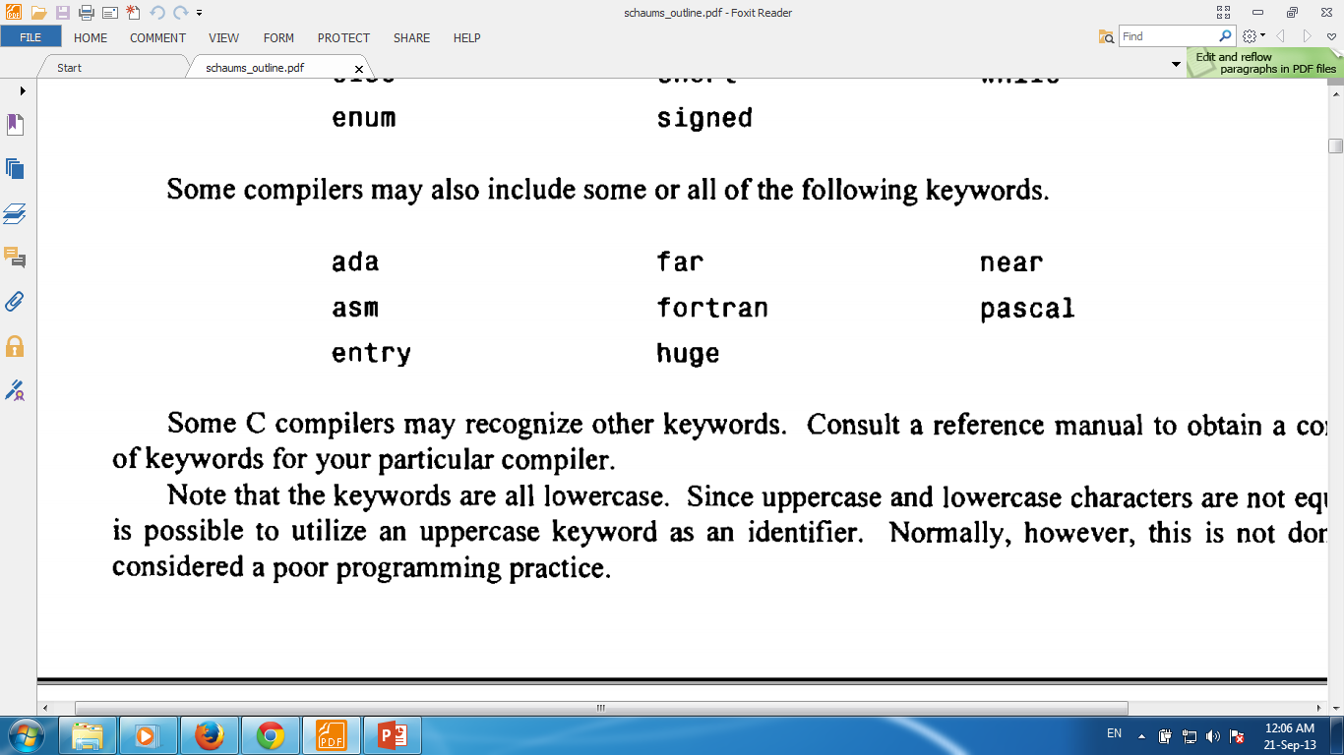
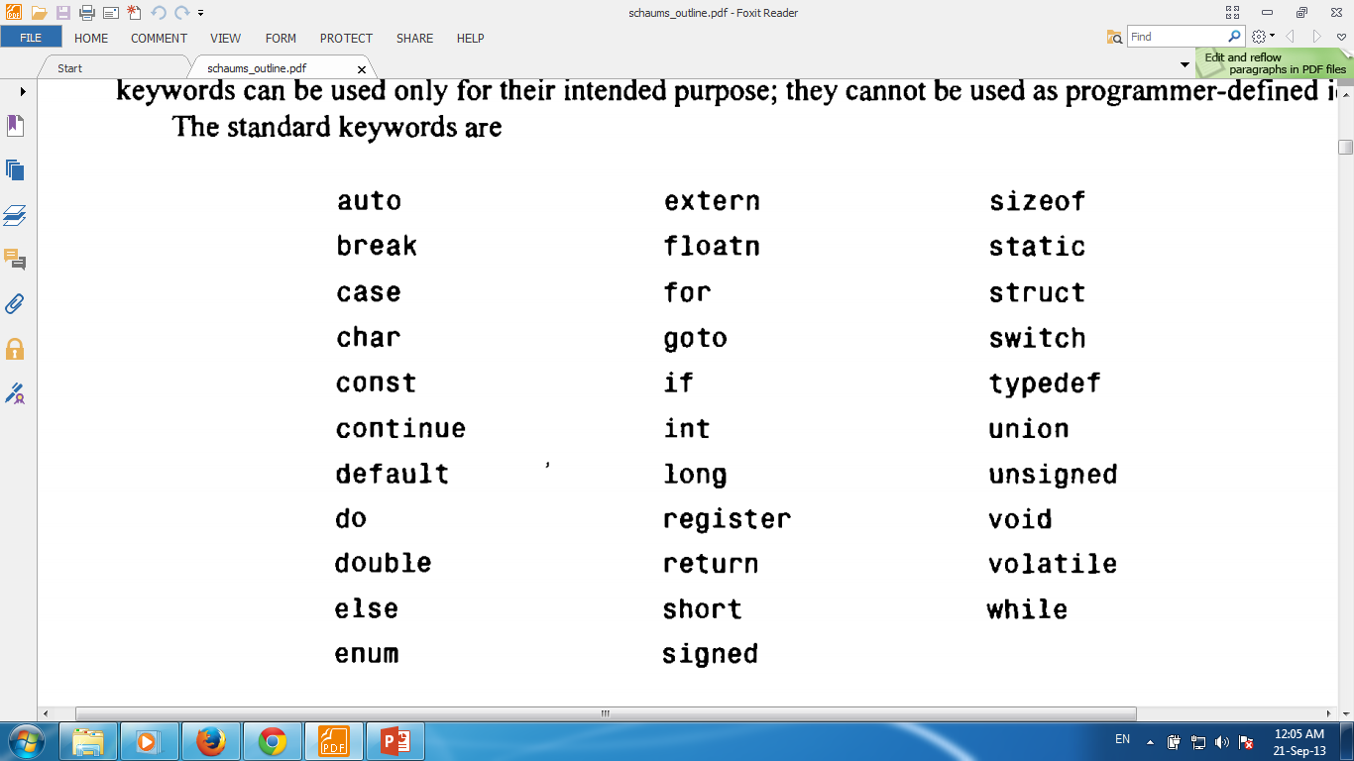
Keywords & Identifier
Every C word is classified as
either a keyword
Or an identifier
All keywords have fixed meanings and these meanings cannot be changed.

Slide 6
Keywords & Identifier
Identifiers are names that are given to various program elements, such as
variables,
functions and
arrays.
These are user defined names. Rules for identifiers given bellow:
First character must be an alphabet (or underscore).
Must consist of only letters, digits or underscore.
Only first 31 characters are significant.
Cannot use a keyword.
Must not contain white space.

Slide 7

Check valid identifier
.
number
1stBoy
Good-girl
addition2value
me123
this_is_long_name
_price1
VaReNdRa

Slide 8
Why invalid?
.
4th
The first character must be letter
“x”
Illegal characters (“)
Order-no
Illegal characters (-)
My variable
Illegal characters (blank space)

Slide 9
Variables
Variables consist of letters and digits, in any order, except that the first character must be a letter.
Both upper-and lowercase letters are permitted, though common usage favors the use of lowercase letters for most types of variables.
Upper- and lowercase letters are not interchangeable (i.e., an uppercase letter is not equivalent to the corresponding lowercase letter.)
The underscore character (_) can also be included, and is considered to be a letter.
An underscore is often used in the middle of an variable.
A variable may also begin with an underscore, though this is rarely done in practice.
Case-sensitive, COUNT and count are not same.

Slide 10
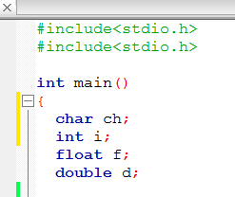
Variables Declaration
Variable is a named memory location that can hold various values.
All variables must be declared before they can be used.
When we declare a variable, we tell the compiler what type of variable is being used.
A declaration associates a group of variables with a specific data type.
To declare a variable, use this general form:
type var-name;
In C, a variable declaration is a statement and it must end in a semicolon (;).
How to Declare Variables?
Inside a function (local variable)
Outside all functions (global variable)
As function’s parameter
Where declare?
Let see the example…

Slide 11
Constants
There are four basic types of constants in C.
integer constants,
floating-point constants,
character constants and
string constants.
Numeric type constant

Slide 12
Integer Constants
An integer constant is an integer-valued number.
Thus it consists of a sequence of digits.
Integer constants can be written in three different number systems: decimal (base 10), octal (base 8) and hexadecimal (base 16).
Several valid decimal integer constants are shown below:
0 1 743 5280 32767 9999

Slide 13
Integer Constants
The following decimal integer constants are written incorrectly for the reasons stated.
12,245
36.0
10 20 30
123-45-6789
0900
illegal character (, ).
illegal character (.).
illegal character (blank space).
illegal character (-)
the first digit cannot be a zero.

Slide 14
Floating Point Constants
A floating-point constant is a base-10 number that contains either a decimal point or an exponent (or both).
Several valid floating-point constants are shown below:
0. 1. 0.2 827.602
50000. 0.000743 12.3 315.0066
2 E-8 0.006e-3 1.6667E+8 .12121212e12

Slide 15
Character Constants
A character constant is a single character, enclosed in apostrophes (i.e., single quotation marks).
Several character constants are shown below.
'A' 'X' '3' '? ' ' '
Notice that the last constant consists of a blank space, enclosed in apostrophes.

Slide 16
Character Constants
Character constants have integer values that are determined by the computer's particular character set.
Some examples are:
See the ASCII character set…

Slide 17
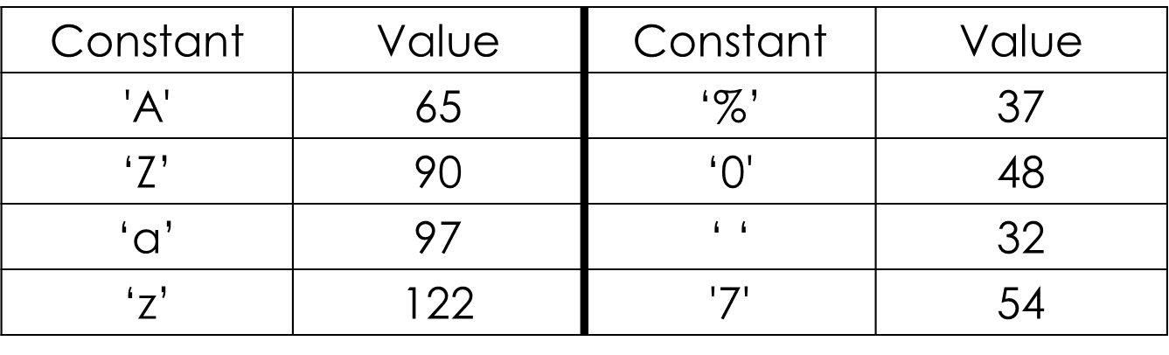
Character Constants
Character constants have integer values that are determined by the computer's particular character set.
Some examples are:
See the ASCII character set…

Slide 18
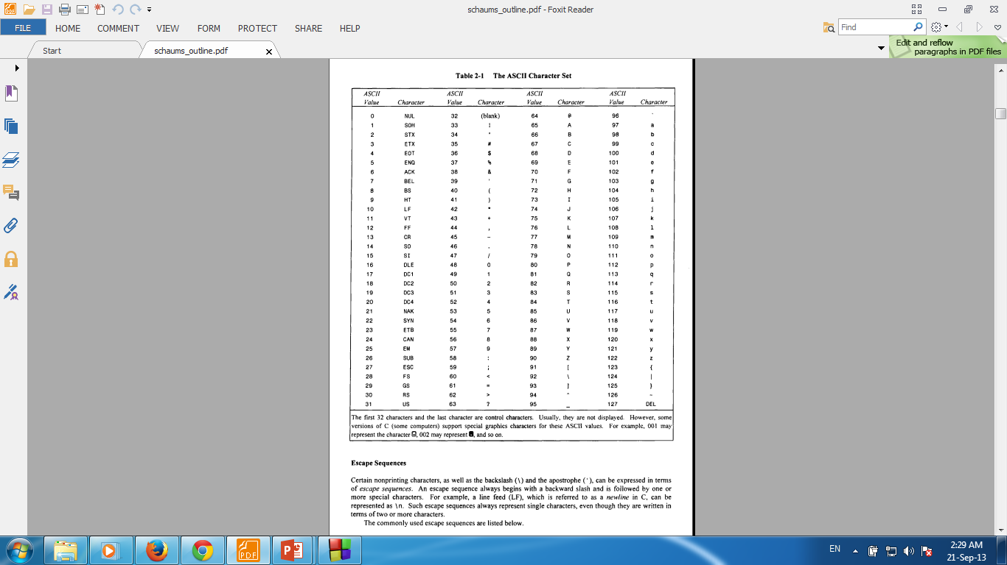
Character Constants

Slide 19
String Constants
A string constant consists of any number of consecutive characters (including none), enclosed in (double) quotation marks.
Several string constants are shown below:
"green" "Washington, D.C. 20005H" "270-32-3456"
"$19.95" "THE CORRECT ANSWER IS:" "2* ( I+3)/J"
" " "Line l\nLine 2\nLine 3" " "

Slide 20
const
// in C, a const is never a compile time constant
const int max = 30;
const int x; // const not initialized: ok in C (error in C++)
void f(int v)
{
int a1[max]; // error: array bound not a constant (max is not a constant!)
int a2[x]; // error: array bound not a constant (here you see why)
switch (v) {
case 1:
// …
case max: // error: case label not a constant
// …
}}

Slide 21
Symbolic Constants
A symbolic constant is a name that substitutes for a sequence of characters.
The characters may represent a numeric constant, a character constant or a string constant.
Thus, a symbolic constant allows a name to appear in place of a numeric constant, a character constant or a string.
When a program is compiled, each occurrence of a symbolic constant is replaced by its corresponding character sequence.
Symbolic constants are usually defined at the beginning of a program.
The symbolic constants may then appear later in the program in place of the numeric constants, character constants, etc. that the symbolic constants represent.
A symbolic constant is defined by writing
#define name value/text

Slide 22
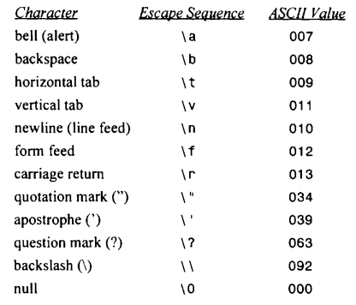
Escape Sequences
Certain nonprinting characters, as well as the backslash (\) and the apostrophe ( ‘ ), can be expressed in terms of escape sequences.
An escape sequence always begins with a backward slash and is followed by one or more special characters.
For example, a line feed (LF), which is referred to as a newline in C, can be represented as \n.
Such escape sequences always represent single characters, even though they are written in terms of two or more characters.
Let see the example…

Slide 23
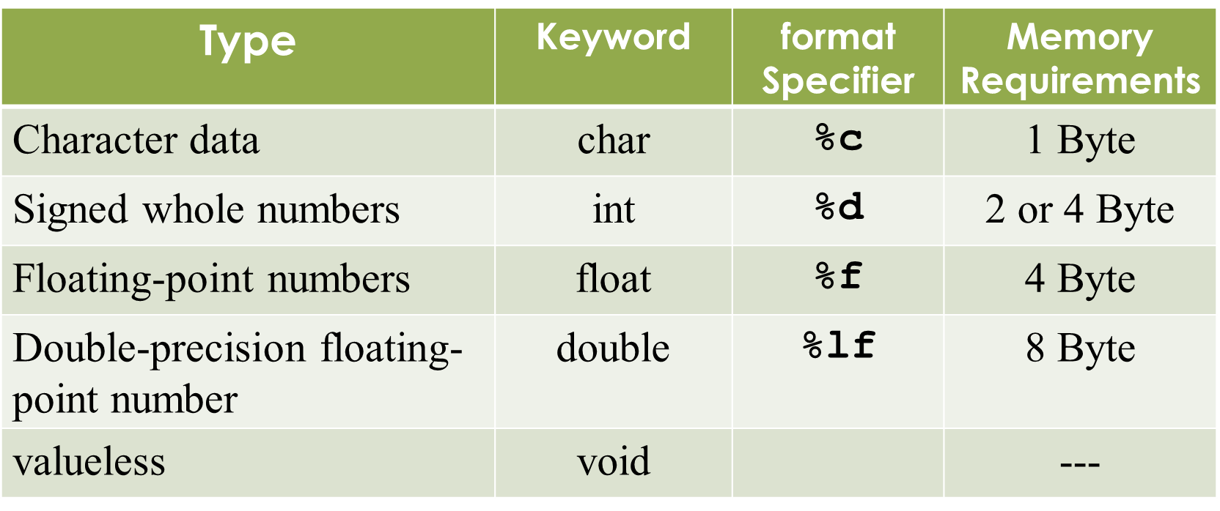
Data types
ANSI C supports classes of data types.
Primary (or fundamental) data types (int, char, float, double, void)
Derived data types (array, functions, structures, pointers)
User-defined data types (typedef int unit)
What’s are C’s Basic (primary) Data Types?

Slide 24
Statements
A statement causes the computer to carry out some action.
There are three different classes of statements in C.
expression statements,
compound statements and
control statements.
An expression statement consists of an expression followed by a semicolon. Several expression statements are shown below.
a = 3;
c = a+b;
i++;
printf ("Area = %f”, area) ;
;

Slide 25
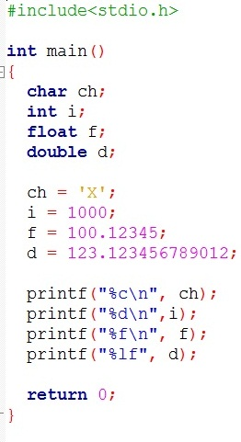
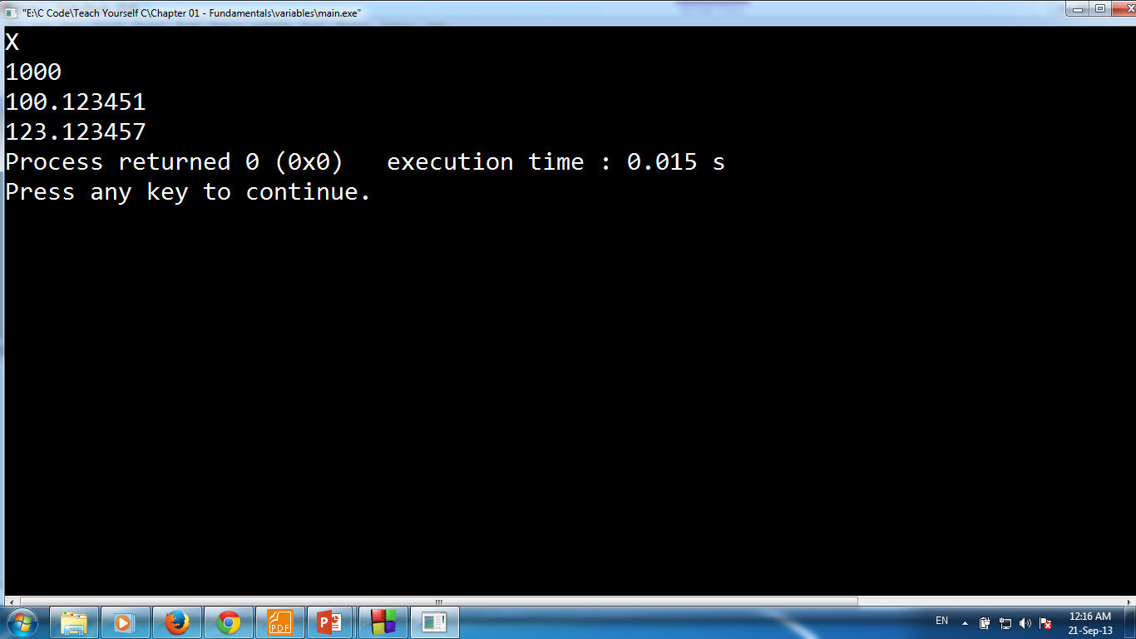
Assign Value to the Variable
To assign a value to a variable, put its name to the left of an equal sign (=).
Put the value you want to give the variable to the right of the equal sign.
It is a statement, so end with a ‘;’
variable
value
;

Slide 26
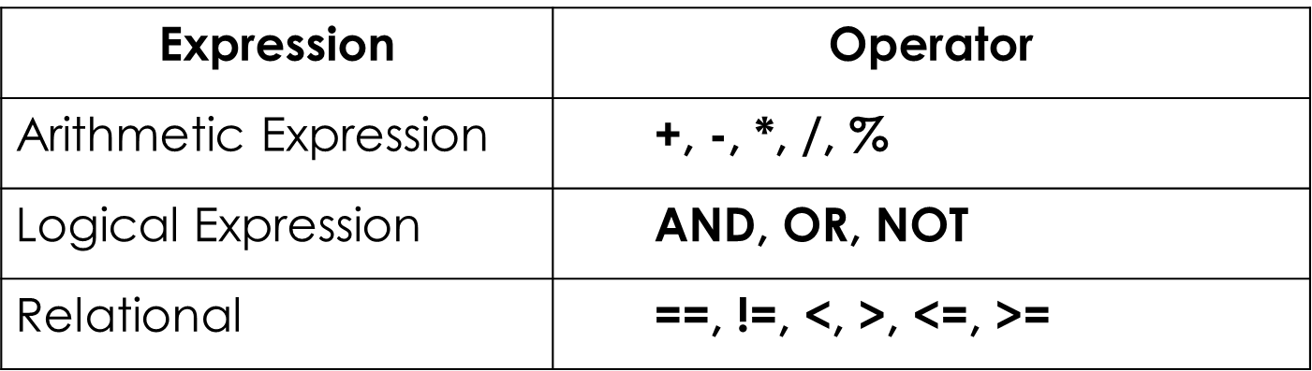
Expressions
An expression is a combination of operators and operands.
C expressions follow the rule of algebra:
a + b
x = y
t = u + v
x <= y
++j
a = 6;
c = a + b;
++j;
expression statements
expressions

Slide 27
Errors
A C program may have one or more of four types of errors:
Syntax errors (Compiler errors or Compile-time errors)
Linker Errors
Runtime errors
Logic errors

Slide 28
Syntax Errors
Syntax errors represent grammar errors in the use of the programming language. Common examples are:
Misspelled variable and function names
Missing semicolons
Unmatched parentheses, square brackets, and curly braces
Using a variable that has not been declared
Incorrect format in selection and loop statements

Slide 29
Linker Errors
Linker errors are generated when the linker encounters what looks like a function call; but it cannot find a function with that name.
This is usually caused by misspelling a C standard function (like main) or not including the header file for a function.

Slide 30
Runtime Errors
A type of error that occurs during the execution of a program is known as run-time error.
Runtime errors may crash your program when you run it. Runtime errors occur when a program with no syntax errors directs the computer to execute an illegal operation.
Common examples are:
Trying to divide by a variable that contains a value of zero
Trying to open a file that does not exist

Slide 31
Logic Errors
Logic errors occur when a programmer implements the algorithm for solving a problem incorrectly. A statement with logical error may produce unexpected and wrong results in the program. Common examples are:
Multiplying when you should be dividing
Adding when you should be subtracting
Opening and using data from the wrong file
Displaying the wrong message
Logic errors are the hardest to find and fix because:
The compiler does not detect these errors
There is no indication of error when the program is executed.
The program may produce correct results for some input data and wrong results for other input data.

Slide 32
Outline
Data Type and Range
Basic Input and Output
Header Files

Slide 33
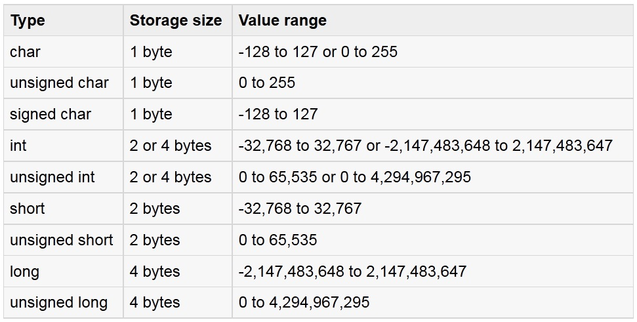
Data Type and Ranges
Integer Type:

Slide 34
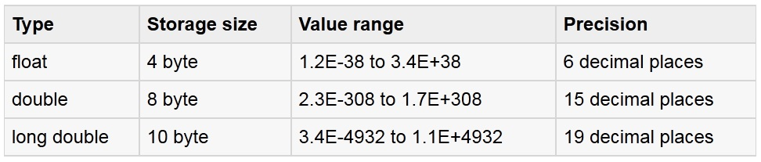
Data Type and Ranges
Float Type:

Slide 35
The % Format Specifiers
%c char single character
%d (%i) int signed integer
%e (%E) float or double exponential format
%f float or double signed decimal
%g (%G) float or double use %f or %e as required
%o int unsigned octal value
%p pointer address stored in pointer
%s array of char sequence of characters
%u int unsigned decimal
%x (%X) int unsigned hex value

Slide 36
The % Format Specifiers
%d (print as a decimal integer)
%6d (print as a decimal integer with a width of at least 6 wide)
%f (print as a floating point)
%4f (print as a floating point with a width of at least 4 wide)
%.4f (print as a floating point with a precision of four characters after the decimal point)
%3.2f (print as a floating point at least 3 wide and a precision of 2)

Slide 37
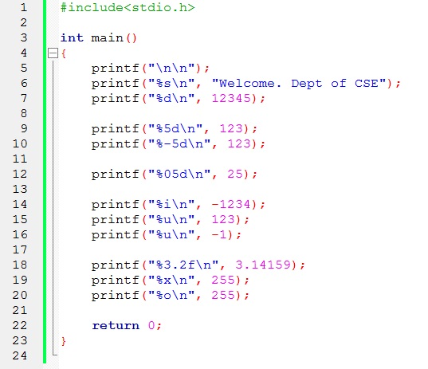
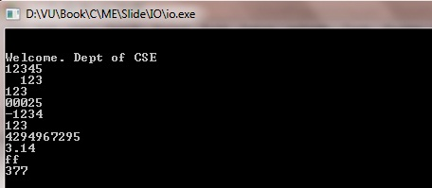
Format Specifiers Example
example

Slide 38
Library Function with Header file
stdio.h: I/O functions:
getchar() returns the next character typed on the keyboard.
putchar() outputs a single character to the screen.
printf()
scanf()
string.h: String functions
strcat() concatenates a copy of str2 to str1
strcmp() compares two strings
strcpy() copys contents of str2 to str1

Slide 39
Library Function with Header file
ctype.h: Character functions
isdigit() returns non-0 if arg is digit 0 to 9
isalpha() returns non-0 if arg is a letter of the alphabet
isalnum() returns non-0 if arg is a letter or digit
islower() returns non-0 if arg is lowercase letter
isupper() returns non-0 if arg is uppercase letter
math.h: Mathematics functions
cos() returns cosine of arg
exp() returns natural logarithm e
fabs() returns absolute value of num
sqrt() returns square root of num
pow() returns power of num as specified

Slide 40
Library Function with Header file
time.h: Time and Date functions
time() returns current calendar time of system
difftime() returns difference in secs between two times
clock() returns number of system clock cycles since program execution
stdlib.h: Miscellaneous functions
malloc() provides dynamic memory allocation
rand() generates random numbers
srand() used to set the starting point for rand()

Slide 41
The getchar() & putchar() functions
The getchar() function reads only single character at a time.
The putchar( c) function displays single character on the screen.
Programming example with getchar( ) and putchar()
char c;
printf( "Enter a value :");
c = getchar( );
printf( "\nYou entered: ");
putchar( c );

Slide 42
The gets() & puts() functions
The gets() function reads a line of text .
The puts() function displays a line of text.
char str[100];
printf( "Enter a value :");
puts(gets(str));

Slide 43
Thank You.
Questions and Answer

Slide 44
References
Books:
Programming in ANSI C By E. Balagurusamy
Teach yourself C. By Herbert Shield
Programming With C. By Byron Gottfried
Web:
www.programmingbasics.org
and other slide, books and web search.
Notes:
License: You are free to read, share, copy, distribute and transmit the work for educational purpose. But not commercial.

